Slide 1


CNSCC.202: HCI
TASK-5
Haotian
Chenhui
Yuekai
Xiao
Zhuohua
Sang
Mao
Yin
Xie
Qi
Notes:
We grouped the functions individually, and then we compared and discussed headings with each other.
In summary, the results are broadly similar, though some diffs appeared among some special funcs.
(NEXT SLIDE) DISPLAY!

Slide 2
Final Result

Slide 3
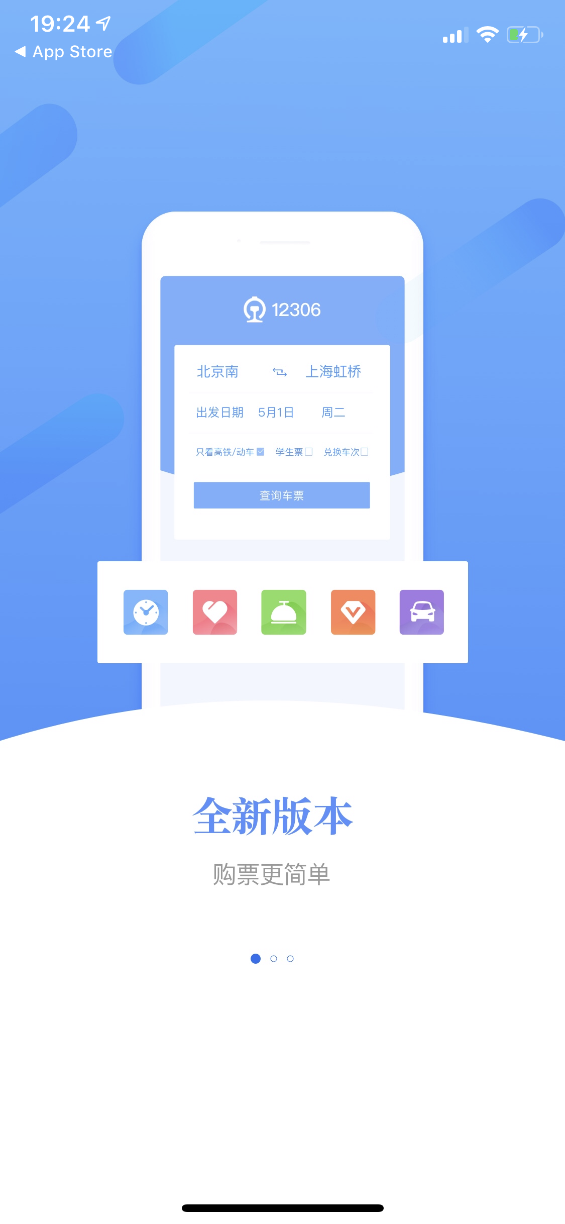
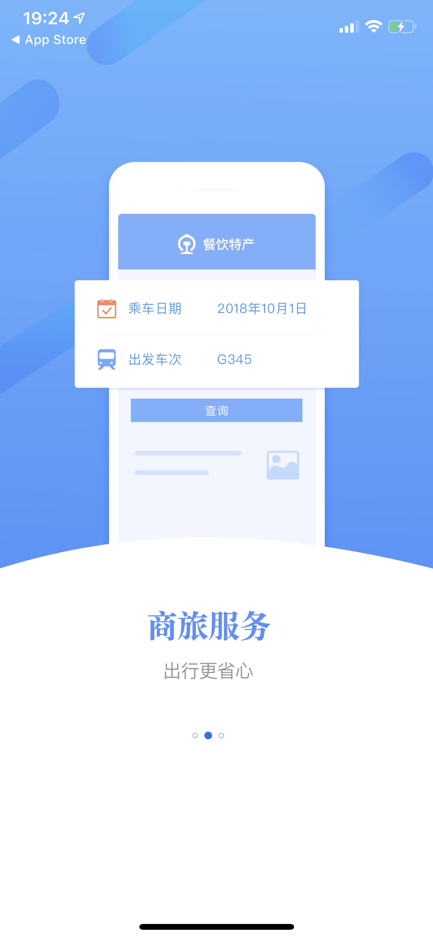
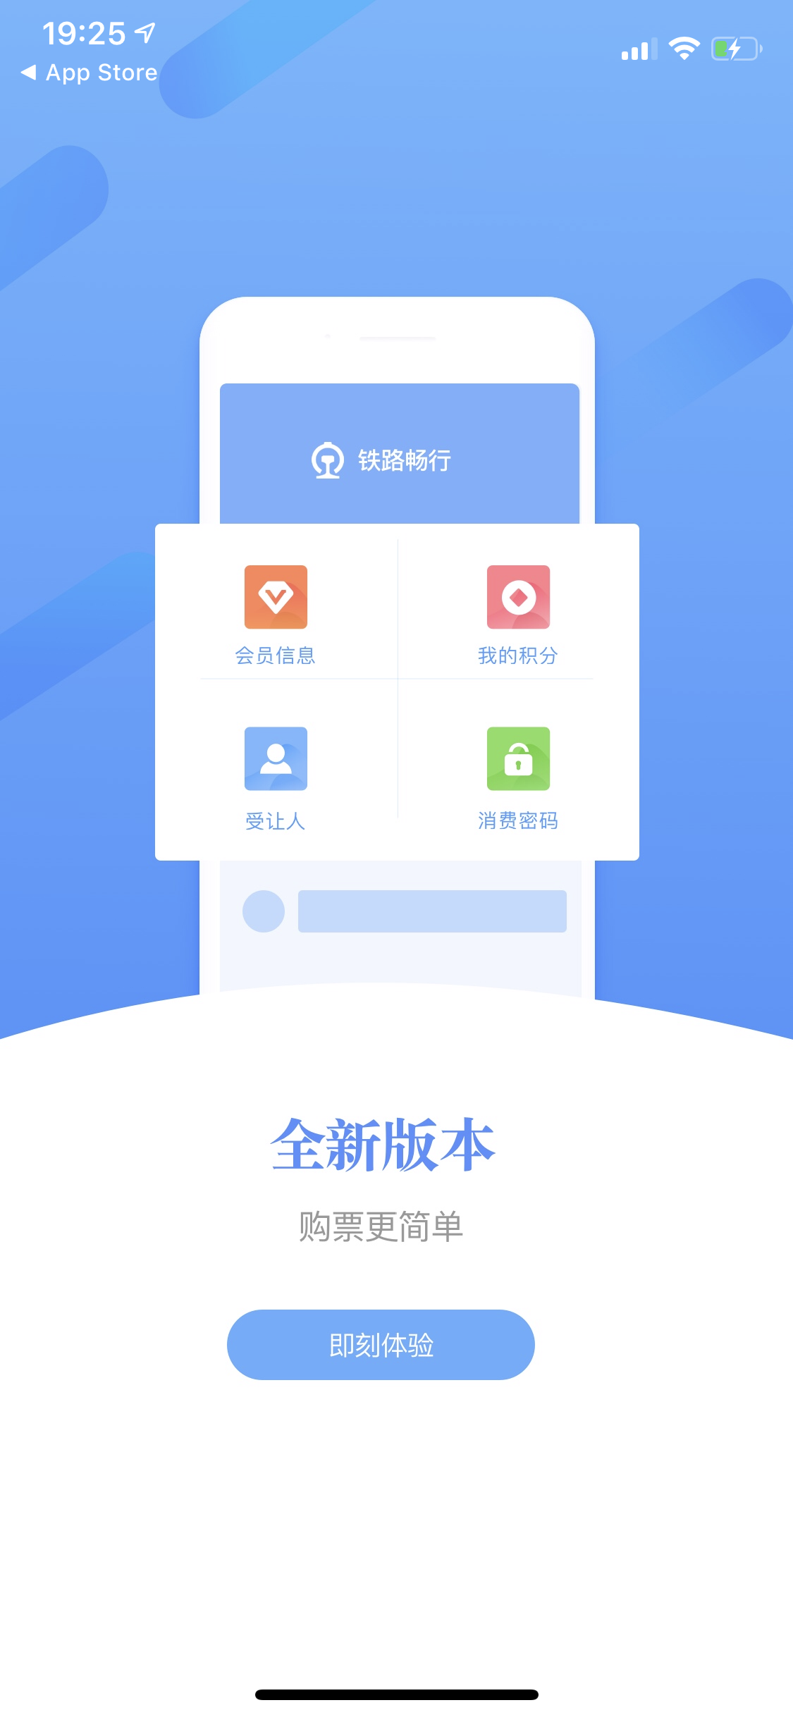


Slide 4

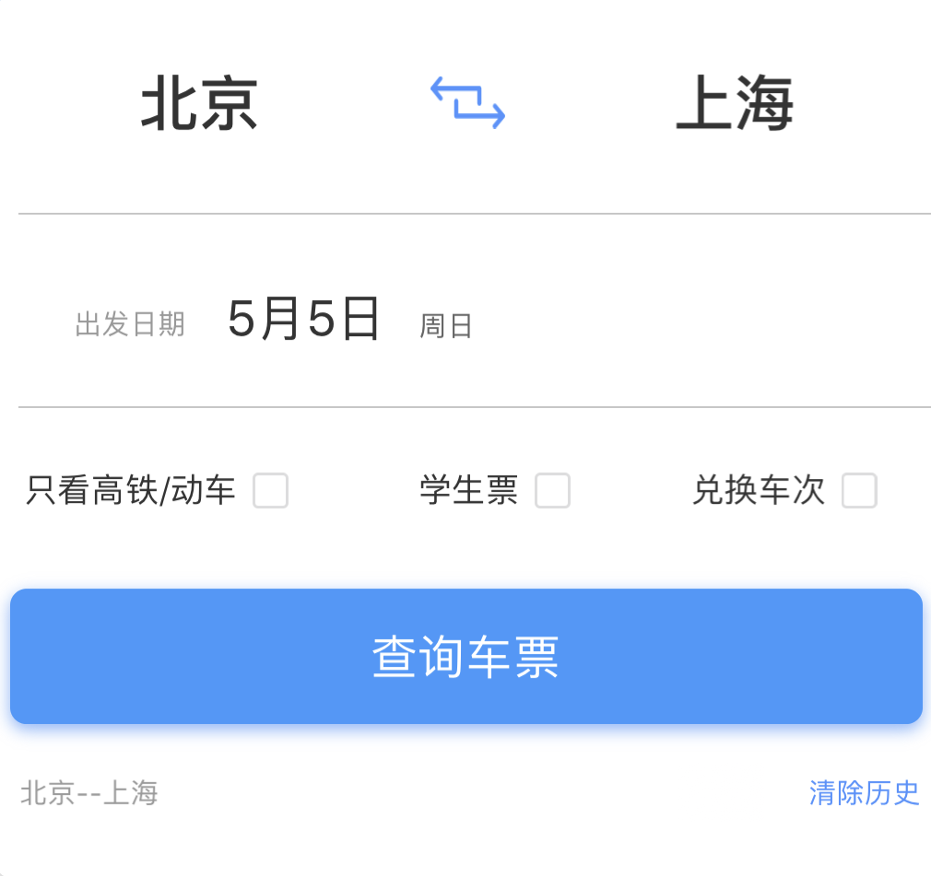
Advantages
Predictability
Button placement satisfied users’ thinking pattern.
Place of departure and destination
Date of departure
Filters (e.g. student tickets only)
Search
Choose one period to buy
Select Passenger
Pay

Slide 5
Advantages
Predictability
Button placement satisfied users’ thinking pattern.
Place of departure and destination
Date of departure
Filters (e.g. student tickets only)
Search
Choose one period to buy
Select Passenger
Pay

Slide 6
Advantages
Predictability
Button placement satisfied users’ thinking pattern.
Place of departure and destination
Date of departure
Filters (e.g. student tickets only)
Search
Choose one period to buy
Select Passenger
Pay

Slide 7
Advantages
Predictability
Button placement satisfied users’ thinking pattern.
Place of departure and destination
Date of departure
Filters (e.g. student tickets only)
Search
Choose one period to buy
Select Passenger
Pay

Slide 8
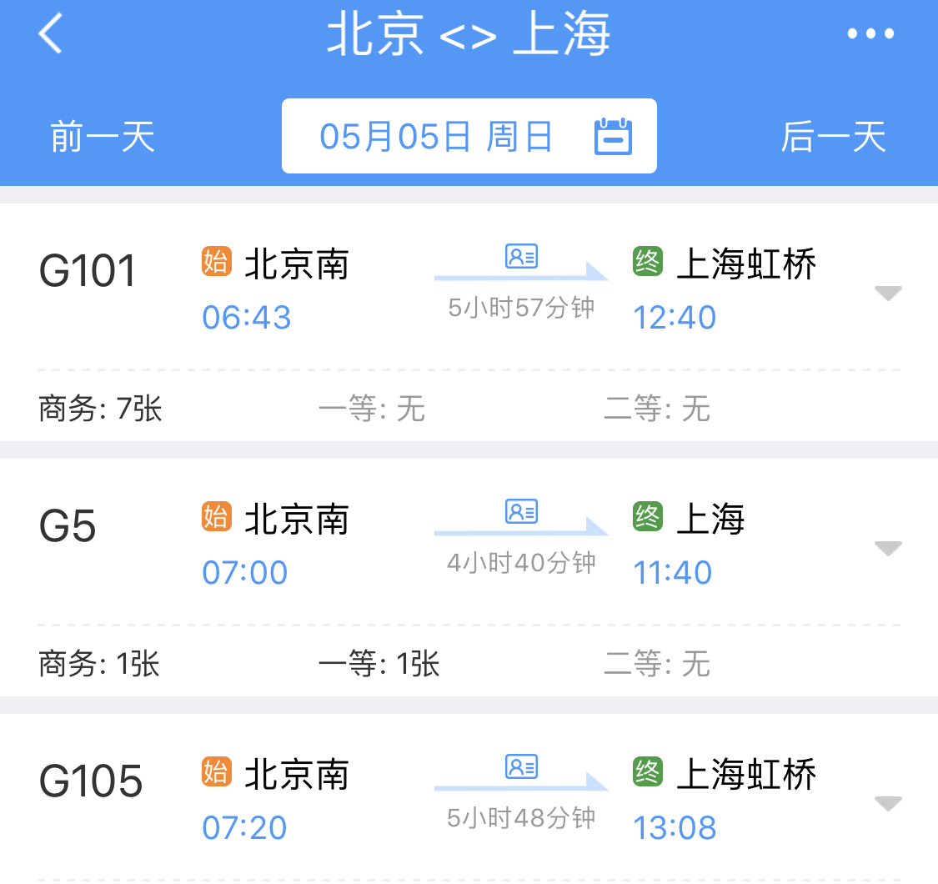
Advantages
Predictability
Button placement satisfied users’ thinking pattern.
Place of departure and destination
Date of departure
Filters (e.g. student tickets only)
Search
Choose one period to buy
Select Passenger
Pay

Slide 9
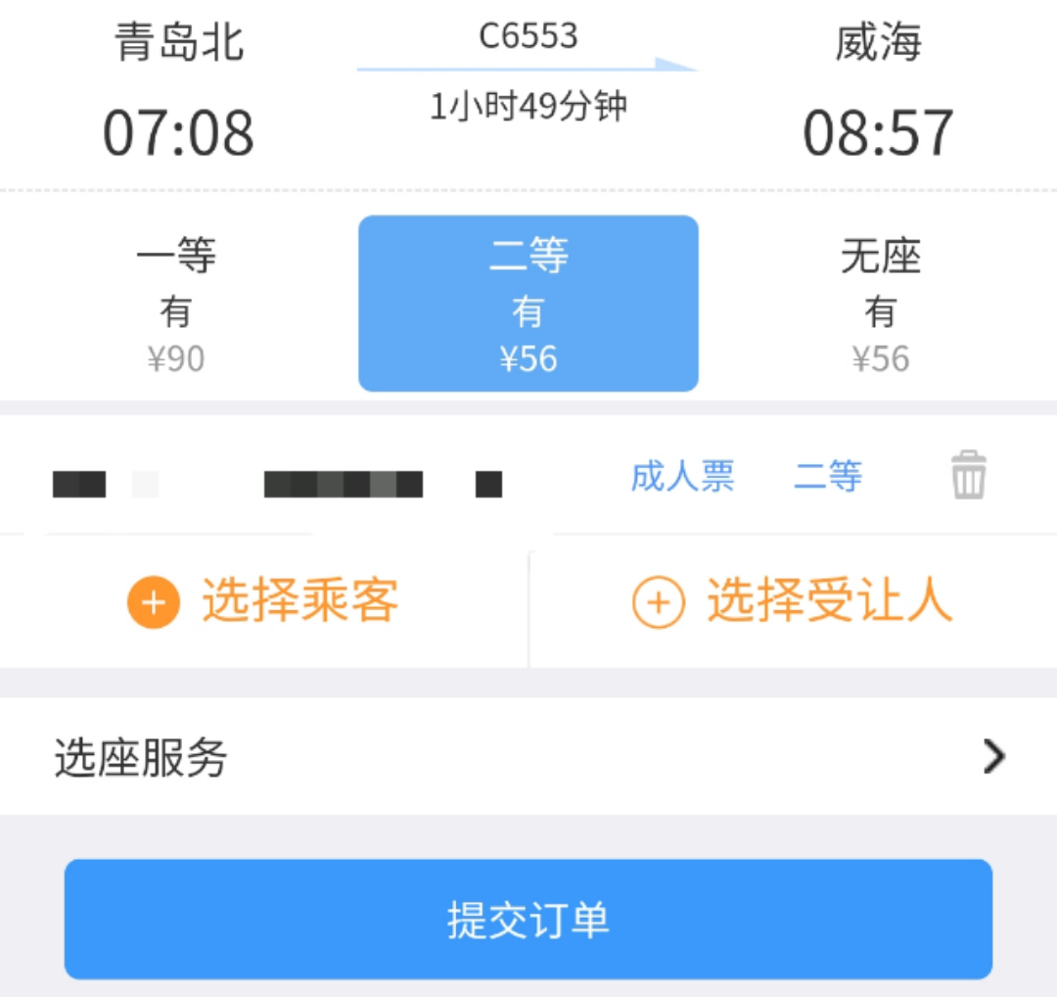
Advantages
Predictability
Button placement satisfied users’ thinking pattern.
Place of departure and destination
Date of departure
Filters (e.g. student tickets only)
Search
Choose one period to buy
Select Passenger
Pay

Slide 10
Advantages
Predictability
Button placement satisfied users’ thinking pattern.
Place of departure and destination
Date of departure
Filters (e.g. student tickets only)
Search
Choose one period to buy
Select Passenger
Pay

Slide 11
Advantages
Familiarity & Strive for Consistency
Have similar layout as other frequent used software such as WeChat, FACEBOOK…

Slide 12
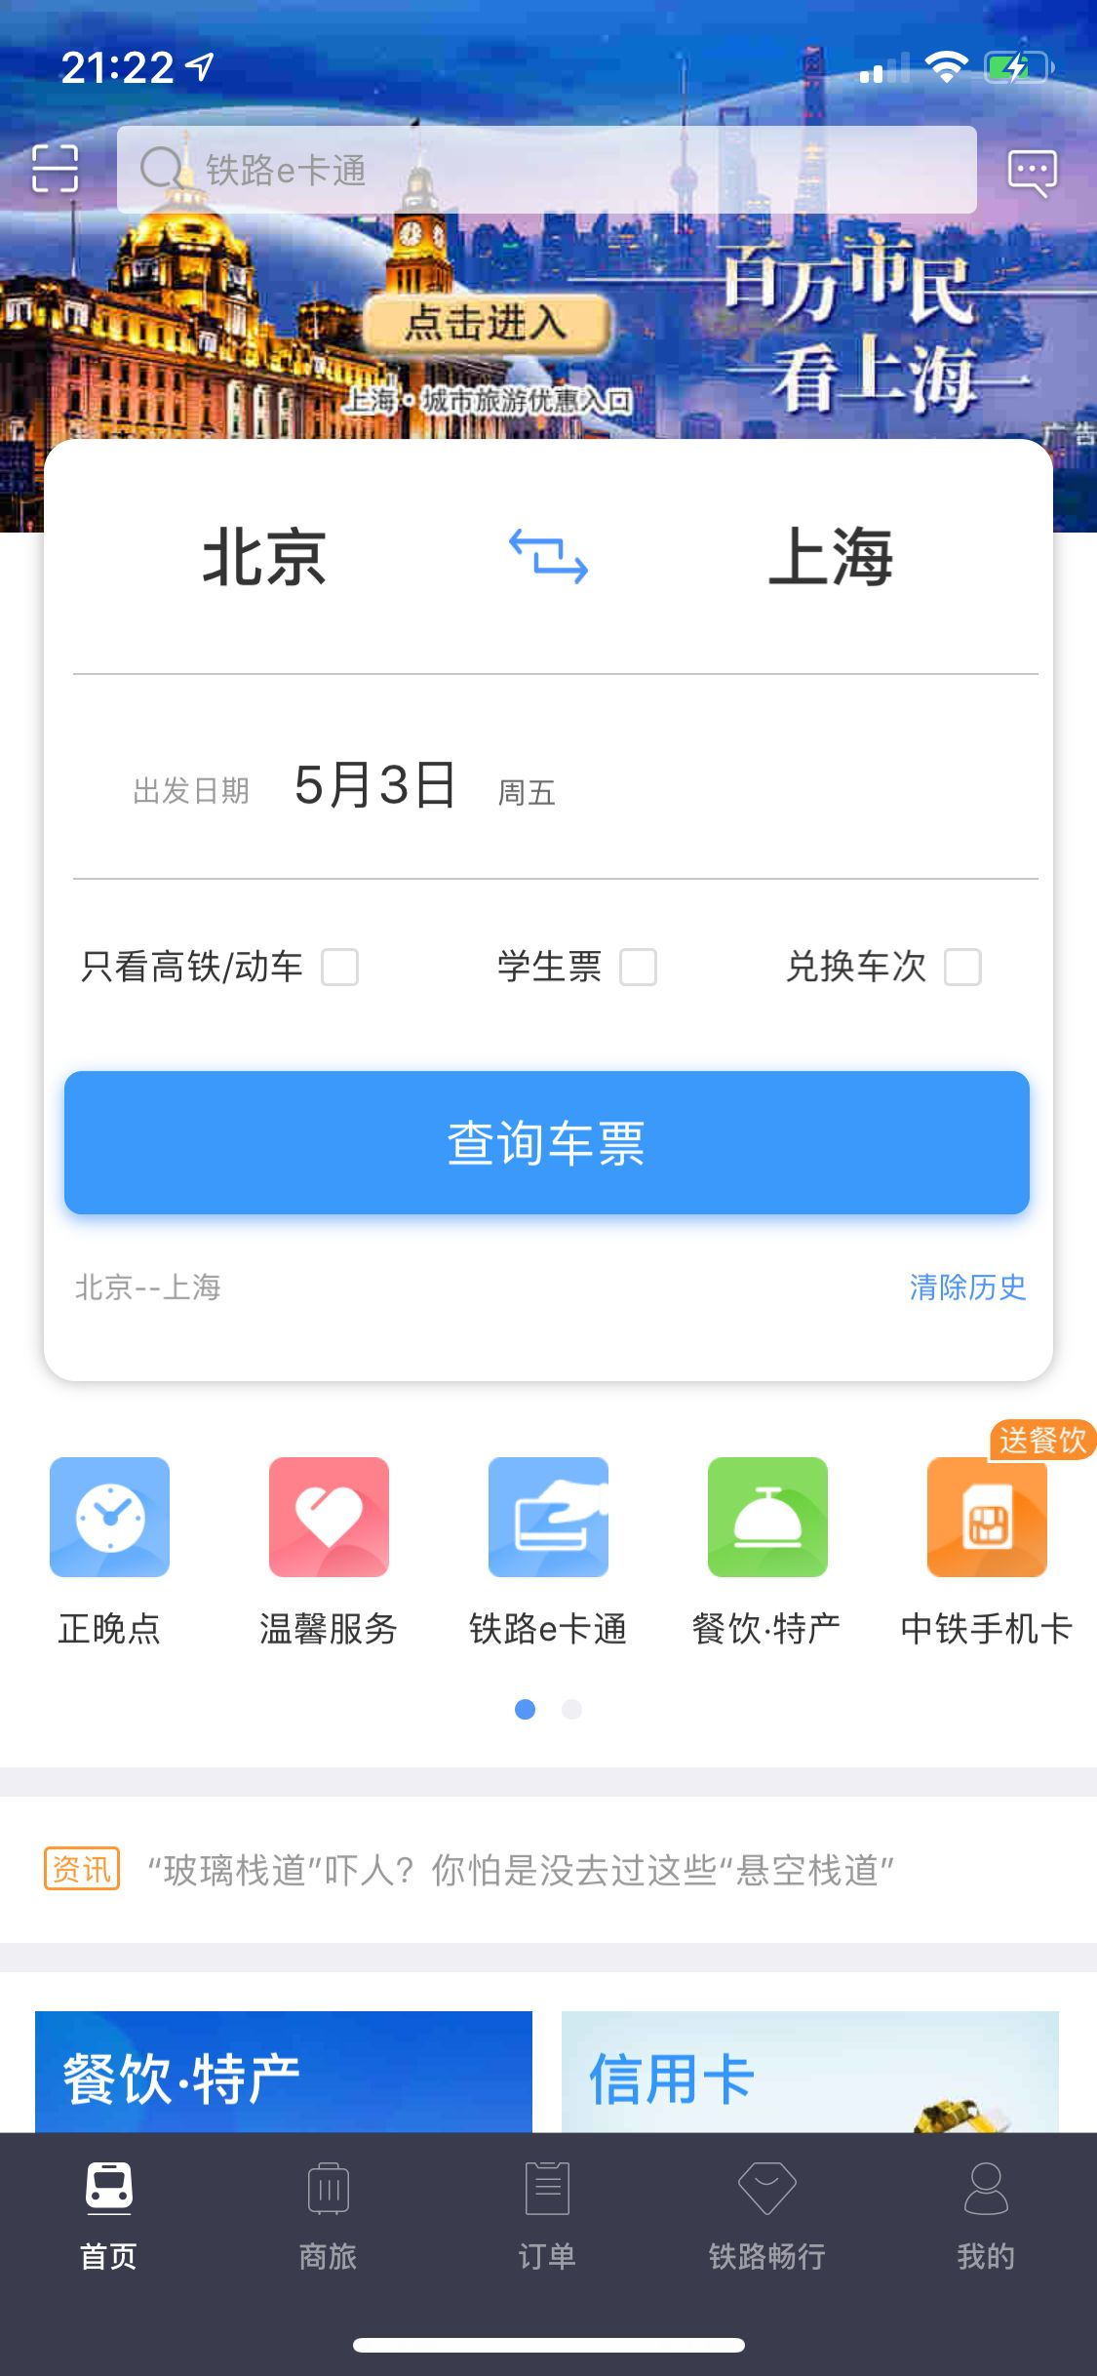


Slide 13
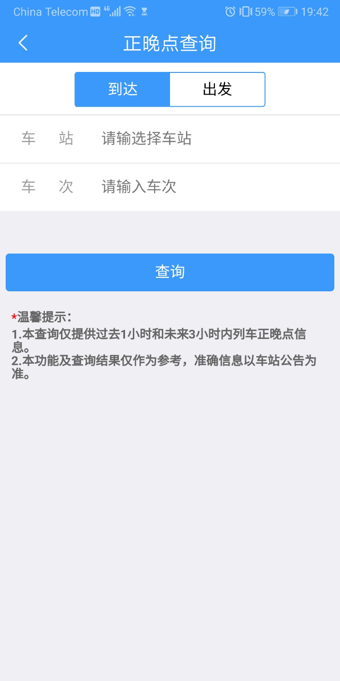
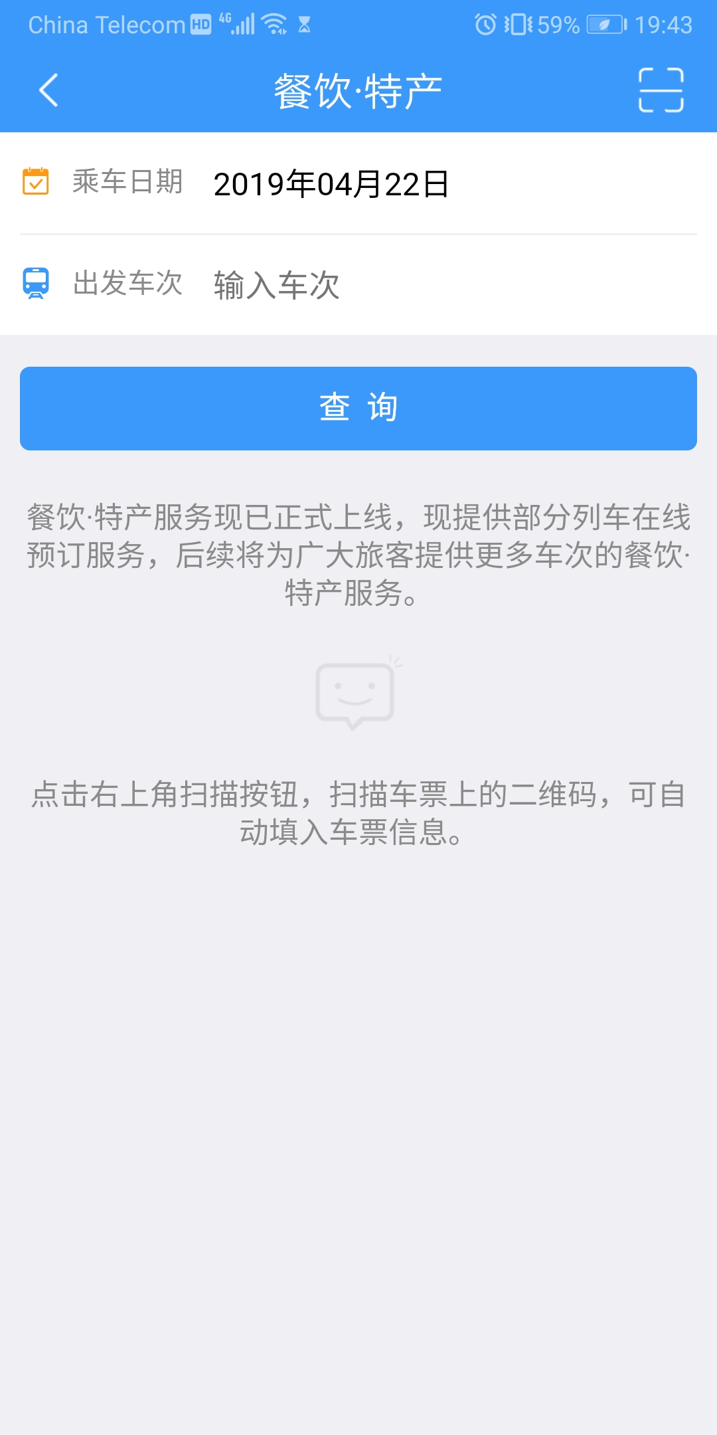
Advantages
Familiarity & Strive for Consistency
Similar operation logic between similar function.
e.g. Reserve for meal & Late query.

Slide 14
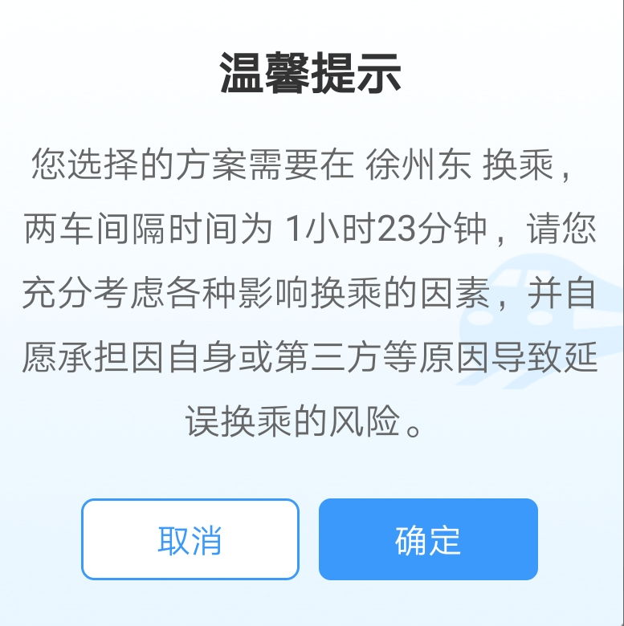

Advantages
Dialog Initiative/System Pre-empt
Provide prompt, if emergence happened.
Dialog Initiative/User Pre-empt
User can use late query for getting rail way information.

Slide 15
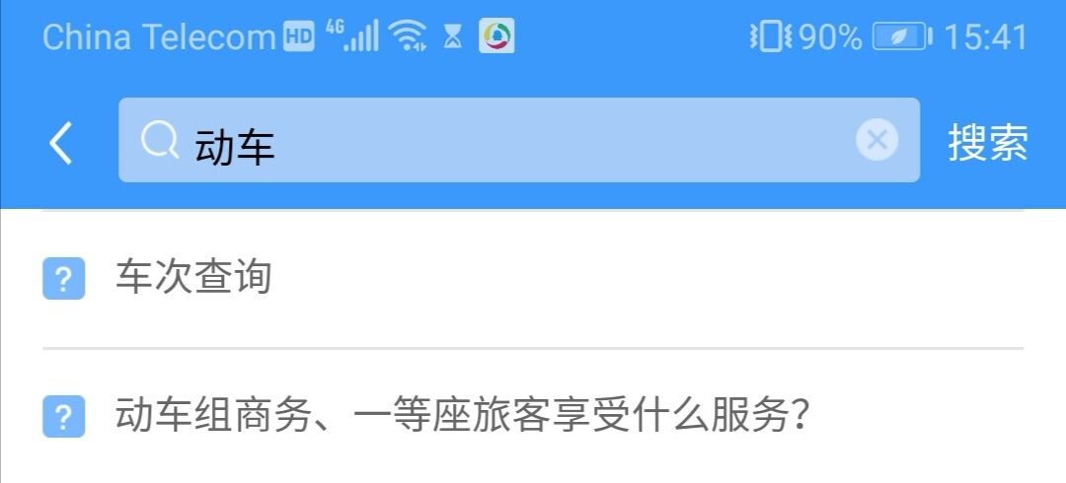
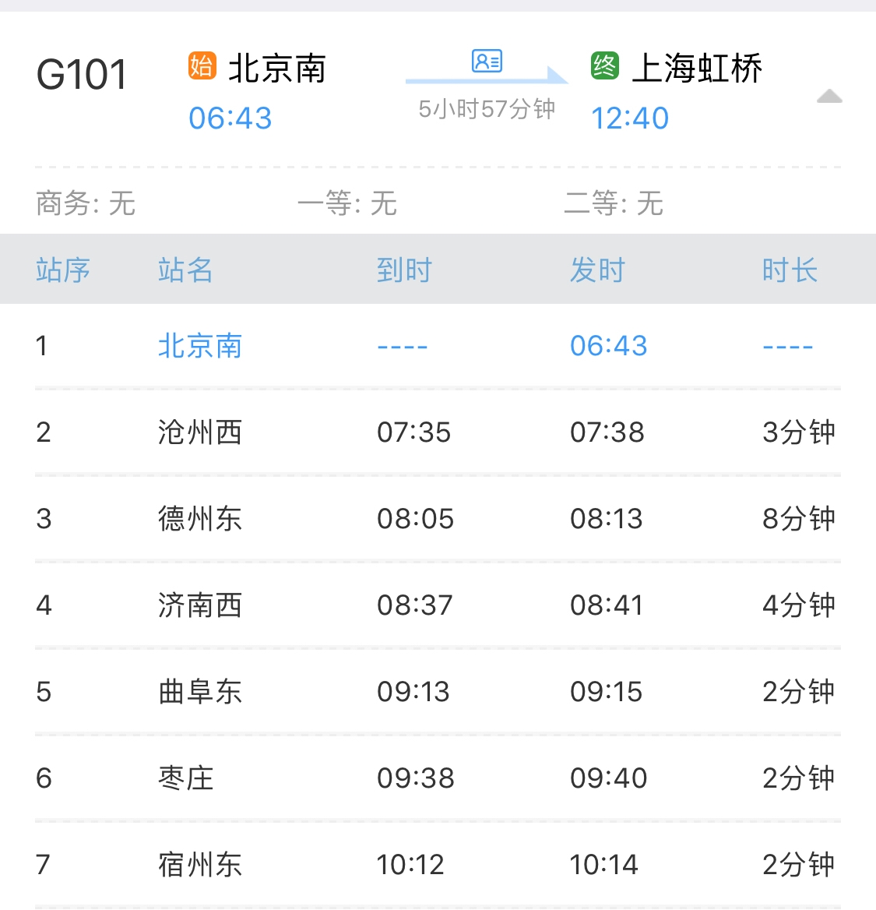
Advantages
Observability defaults
While querying, system will suggest possible words based on user’s input.
Responsiveness
Stable response time as user clicking on every button.
Reduce short-term memory
Load simple and clear display for information.

Slide 16
Disadvantages | Improvement
Synthesizability
No feedback for pressing a button, users will have no idea whether they have chosen the right option. | Add a feedback for pressing a button, a simple highlight could work.
Consistency
During the Late query, it lack the shortcut option of QR code scanning operation like other functions do, which creates burden. | Add the shortcut option of QR code scanning into Late Query.

Slide 17
Disadvantages | Improvement
Task migratability
No option of telephone reservation once fail to reserve the tickets. | Add an option for telephone reservation
Customizability
No options for preference setting or changing font, color of its UI. | Adding an option for preference setting that user can adjust the font and background color.

Slide 18
Disadvantages | Improvement
Recoverability
Once Exception happened the app will crash, only restart the app can work. | The system should consider that once exception happens, the app should go back to the previous state.
Task conformance
Although satisfied most user’s expectation, lack of remind function ahead of the schedule for the train depart. | The app should provide remind function that will remind the user ahead of time for the train that is going to leave.

Slide 19
Shneiderman’s Eight Golden Rules
Strive for consistency |  | The app has Similar layout, command use as other apps.
Enable frequent users to use shortcuts |  | No shortcuts for users.
Offer informative feedback |  | Inform the user once loading is finished.
Design dialogs to yield closure |  | Once successfully reserved tickets, it will provide the order information.

Slide 20
Shneiderman’s Eight Golden Rules
Offer error prevention and simple error handling |  | Inform the user to input detailed information before buying the tickets.
Permit easy reversal of actions |  | No such function.
Support internal locus of control |  | Version update will not changing operation logic.
Reduce short-term memory load |  | Simple display of ticket information.

Slide 21
Work Division

Slide 22
Content
Advantages: | Haotian Sang & Xiao Xie
Disadvantages & Improvement | Zhuohua Qi & Yuekai Yin
Shneiderman’s Eight Golden Rules | Chenhui Mao
PPT | Chenhui Mao & Zhuohua Qi & Yuekai Yin
Presentation: | Haotian Sang & Xiao Xie

Slide 23
Individual Work
Name: | Haotian Sang
ID Number: | 16722022
Contribution: | Analyzed the principle and structure/layout/navigation

